Slide 1
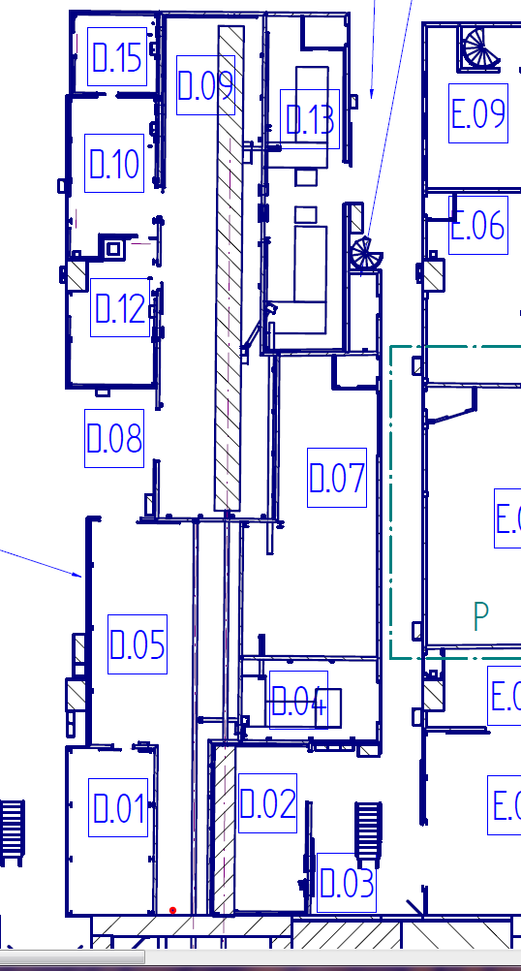
SPB OPT Radiation Measurements
28.07.17
07:00-11:00
NO ACESS To:
FXE EXP D.05
FXE Laser D.04
Pump Room (XTD 9 Adjacent)
Balcony Room (XTD 9 Adjacent)
SASE 1 Roof

Slide 2
SPB/SFX EXP Radiation Measurements
28.07.17
11:00-17:00
NO ACESS To:
SPB Control D.15
SFX Control D.10
SPB Laser D.13
Pump Probe Laser D.07
SPB OPT D.02
FXE EXP D.05
Pump Room (XTD 9 Adjacent)
Balcony Room (XTD 9 Adjacent)
SASE 1 Roof

Slide 3
FXE EXP Radiation Measurements
03.08.17
9:00-15:00
NO ACESS To:
FXE Control D.01
FXE Laser D.04
Pump Probe Laser D.07
SPB OPT D.02
SPB EXP D.09
Pump Room (XTD 9 Adjacent)
Balcony Room (XTD 9 Adjacent)
SASE 1 Roof

