Slide 1
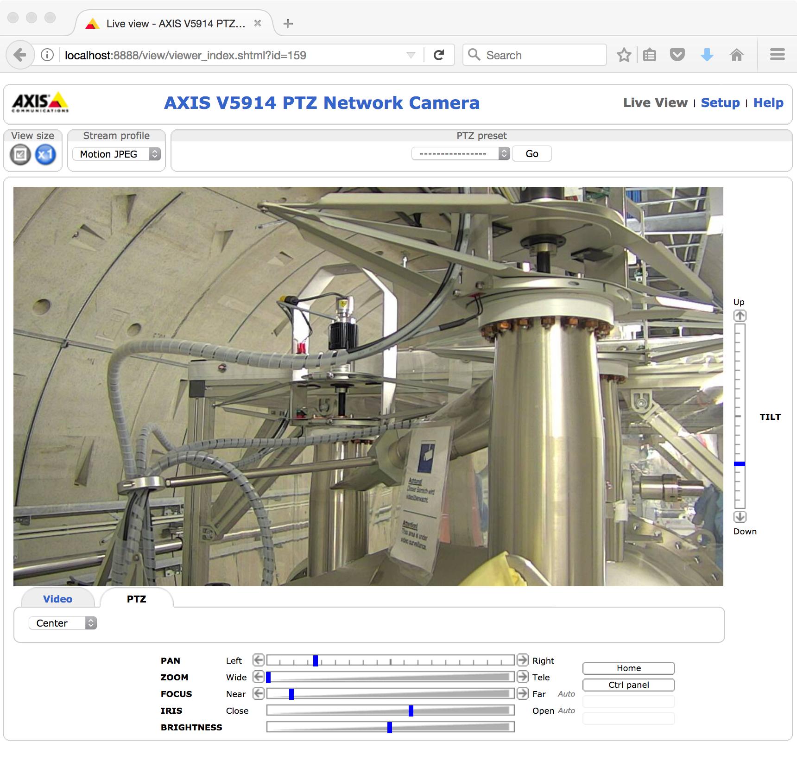
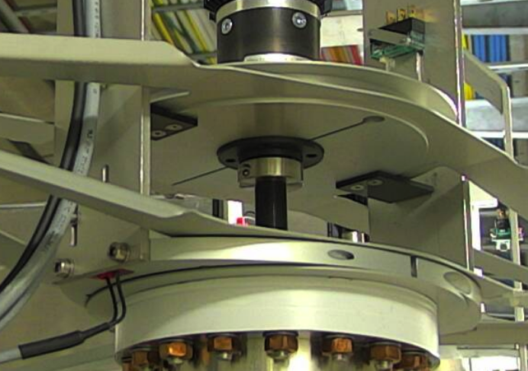
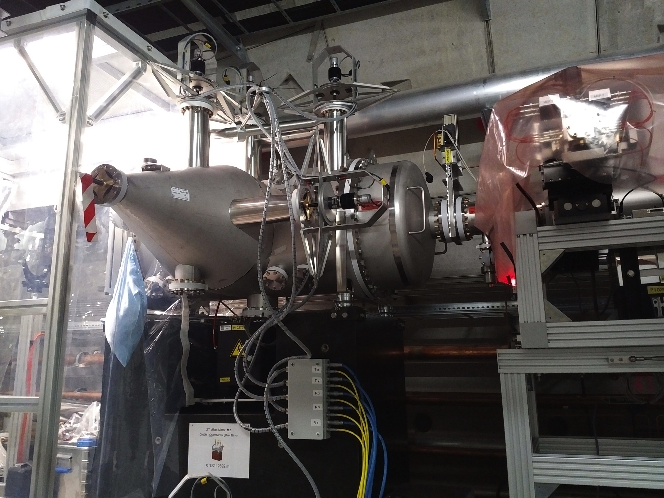
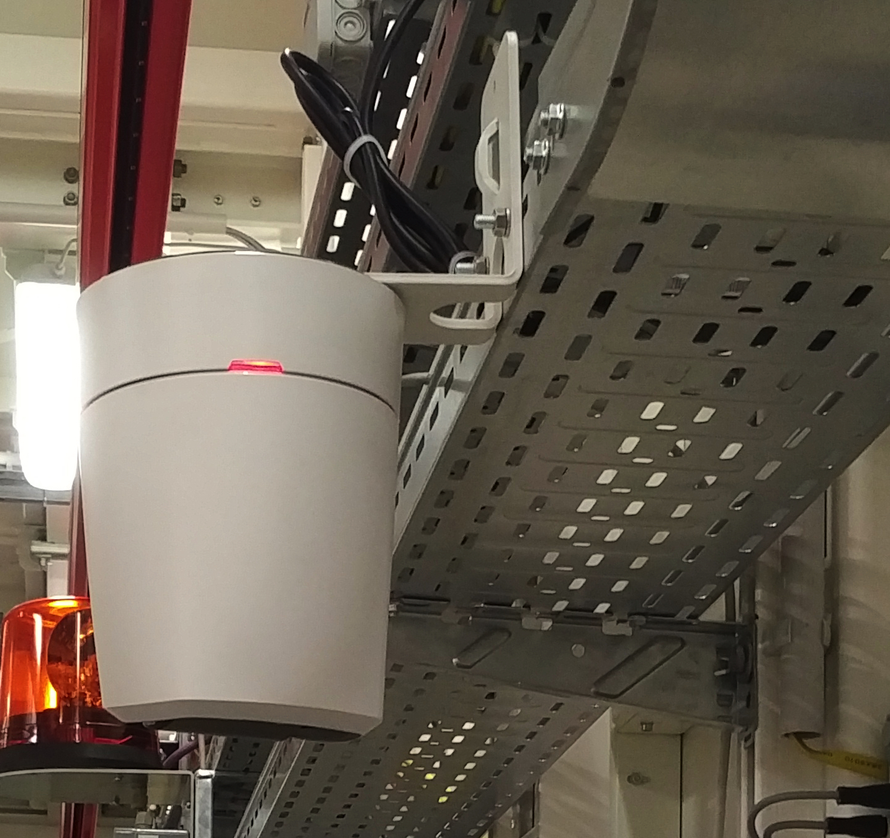
Web cameras in SASE1 tunnels
6x AXIS V5915 are in procurement
A test AXIS V5914 (SPB) camera is installed looking at M3
used for remote control & functional tests of mirror motors
The first of our new cameras will be used for monitoring M2 motors

