Slide 1
XGM resistor issue
Dr. Jan Grünert
X-ray Photon Diagnostics
Group Leader
Hamburg, February 2nd, 2017
This presentation is based on information and reports
by K.Tiedtke and F.Jastrow from DESY-FS-FL-D

Slide 2
Summary and Description of Issue
Each vacuum chamber of each XGM contains several electrodes which are connected to High Voltage supplies and signal output via capacitors and a certain number of resistors. These capacitors and resistors are in vacuum.
These electrical systems were tested in several ways during construction, calibration with X-rays, and after installation. All systems were tested OK (operational) with X-ray synchrotron beam.
In 01/2017 tests showed an irregular behavior of some electrodes, and subsequent tests (“pulsing test”) have concluded that four of our six XGMs have broken resistors.

Slide 3
Pulsing test results (26.1.) – example for OK
.

Slide 4
Pulsing test results (26.1.) – example for NOK
.

Slide 5
Pulsing tests - Result Matrix

Slide 6
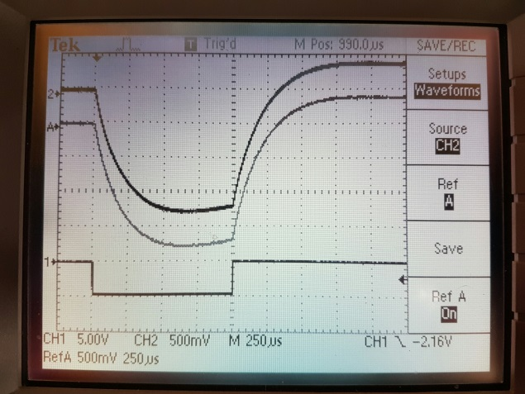
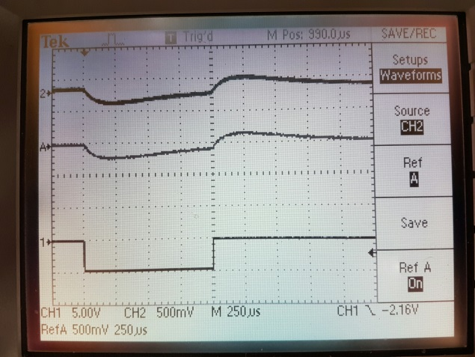
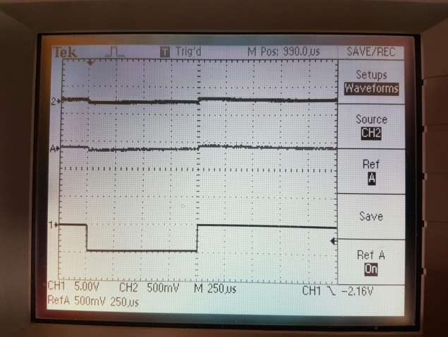
Checking the pulsing test itself
(is this a valid test method?)
13:10
pulse input FCe
Fini checked XGMD-Flash2 #003 (aka XGMD in Flash2 Hall).
This XGM is a unit that is currently operating with beam.
This test shows (un)fortunately the expected traces.
top trace (2) e1,
middle trace (A) e2,
bottom trace (1) pulse.
Conclusion:
The pulsing test is OK as a method.
13:11
pulse input mesh.e
13:12
pulse input mesh.ion

Slide 7
Analysis progress this week (w5) by DESY team
The new “pulser test” was verified at an operational XGMD at FLASH. The test method is OK. This means that the test results from last week on all our XGMs are REAL.
25% of resistors in XGMD/XBPMs affected (9 of 36),
0% of resistors in HAMPs affected, no capacitors affected.
An XGMD chamber at FLASH was tested-to-destruction-of-resistor by applying a large differential voltage (>3kV) between neighboring electrodes. These resistors (Caddock MS220) have a nominal voltage breakthrough rating of 500V but never had issues. They are used in all our XGMs.
New, other resistors (Ohmite MOX-1N-13) with higher voltage breakthrough rating of 10kV were procured and arrived 31.Jan. Even better version with 20kV rating will be at DESY 6.Feb.2017
The new resistors were built into the tested-to-destruction XGMD at FLASH, unit pumped, tested with applying HV up to 14kV (on both Caddoc and Ohmite resistors). New resistors survive.

Slide 8
Plan next week (w6) by DESY team
RGA check of new resistors at DESY
XGM01 at HERA-S will be opened tuesday and resistors exchanged.
If all electrical and RGA tests acceptable on XGM01, then all other XGMs (XBPM chambers) will be opened and all 36 resistors exchanged (no matter if the old pulser tests were ok or not).
Start with XTD2 (most urgent and difficult).
Regular XGM@SASE1 installation plan for next week (w6)
XGM@XTD2: put into vacuum control system
XGM@XTD9: wiring of vacuum-to-Beckhoff, installation of Keithleys etc., wiring terminals (2x) on girder, cables from girder terminals to rack
Both: test of serial communication from DOOCS to Keithleys/SRG/RVC300/HV-crate

